Slide 1

Building a Sentiment Analysis Pipeline for Product Reviews
This comprehensive project demonstrates how to build an automated sentiment classification system that analyzes product reviews and categorizes them as Positive, Negative, or Neutral. Companies leverage such systems to quickly understand customer opinions at scale, enabling data-driven decisions about products, services, and brand perception. This pipeline combines classical machine learning techniques with modern NLP approaches to deliver actionable insights from unstructured text data.

Slide 2







Project Goals and Core Objectives
Primary Goal
Data Acquisition
Develop a robust classification system that accurately categorizes written product reviews into three distinct sentiment categories: Positive, Negative, or Neutral, enabling automated analysis of customer feedback.
Source and prepare a comprehensive dataset of customer reviews with pre-labeled sentiments, ensuring sufficient samples across all categories for balanced model training.
Text Preprocessing
Model Development
Transform raw, unstructured text into clean, standardized formats through tokenization, normalization, and vectorization techniques that prepare data for machine learning algorithms.
Train and optimize machine learning or deep learning models using the preprocessed data, selecting algorithms that balance accuracy with computational efficiency.
Performance Evaluation
Interface Creation
Rigorously assess model performance using industry-standard metrics including accuracy, precision, recall, and F1-score to ensure reliable predictions across all sentiment classes.
Build an intuitive testing interface that allows stakeholders to input new reviews and receive instant sentiment predictions, demonstrating real-world applicability.

Slide 3
Essential Tools and Technology Stack
Core Python Libraries
Advanced & Visualization
Pandas & NumPy form the foundation for efficient data manipulation and numerical computations. These libraries handle dataframe operations, statistical calculations, and array processing essential for managing large review datasets.
TensorFlow/Keras or PyTorch enable deep learning implementations including Recurrent Neural Networks (RNN), Long Short-Term Memory (LSTM) networks, and transformer architectures for state-of-the-art sentiment analysis performance.
NLTK or SpaCy provide comprehensive NLP capabilities including tokenization, part-of-speech tagging, named entity recognition, and stop-word removal. SpaCy offers faster processing, whilst NLTK provides extensive linguistic resources.
Matplotlib & Seaborn create compelling visualizations of model performance, confusion matrices, sentiment distributions, and training metrics that communicate results effectively to stakeholders.
Dataset Sources: Leverage publicly available datasets such as Amazon Product Reviews, IMDb Movie Reviews, or Yelp Business Reviews, ensuring pre-labeled sentiment annotations for supervised learning.
Scikit-learn delivers classical machine learning algorithms like Naive Bayes and Support Vector Machines, along with robust evaluation metrics, cross-validation tools, and preprocessing utilities for text classification tasks.

Slide 4
Data Collection and Initial Loading
01
02
Dataset Selection
Data Structure Verification
Identify and download suitable public datasets from repositories like Kaggle, UCI Machine Learning Repository, or Amazon Web Services Open Data. Prioritize datasets with balanced class distributions.
Ensure the dataset contains at minimum two essential columns: Review Text (the actual customer feedback) and Sentiment Label (typically encoded as 1 for Positive, 0 for Negative, and 2 for Neutral).
03
04
Initial Data Exploration
Load into Memory
Conduct exploratory data analysis to understand dataset characteristics including review length distribution, class balance, missing values, duplicate entries, and overall data quality indicators.
Use Pandas to load the dataset efficiently, applying appropriate encoding settings and data types to optimize memory usage whilst ensuring all text is properly decoded and accessible.

Slide 5





Critical Data Preprocessing Pipeline
Text preprocessing represents the most crucial phase of any NLP project. Raw text cannot be directly consumed by machine learning models, requiring systematic transformation into numerical representations whilst preserving semantic meaning.
Text Cleaning
Remove HTML tags, special characters, URLs, email addresses, and excessive whitespace. Convert all text to lowercase for consistency. Handle contractions and expand abbreviations to standardise vocabulary.
Tokenization
Split continuous text into discrete units (tokens) such as words, sub-words, or characters. This creates structured input for subsequent processing steps and enables statistical analysis of word frequency.
Stop Word Removal
Eliminate common words like "the," "a," "is," "are" that occur frequently but contribute minimal semantic value. This reduces feature dimensionality whilst retaining meaningful content words.
Stemming/Lemmatization
Reduce words to their root forms: "running," "runs," "ran" all become "run." Lemmatization provides grammatically correct roots, whilst stemming uses heuristic rules for faster processing.
Feature Extraction
Convert cleaned text into numerical vectors using Bag-of-Words (BoW), TF-IDF weighting, or advanced word embeddings (Word2Vec, GloVe, BERT). This vectorization enables mathematical operations by ML algorithms.

Slide 6
Feature Extraction Techniques Comparison
Traditional Approaches
Advanced Embeddings
Bag-of-Words (BoW) creates sparse vectors by counting word occurrences in each document. Simple and interpretable, but ignores word order and context. Works well for shorter texts with clear sentiment indicators.
Word2Vec & GloVe generate dense vector representations that capture semantic relationships between words. Similar words have similar vectors, enabling the model to understand contextual meaning and handle synonyms effectively.
TF-IDF (Term Frequency-Inverse Document Frequency) weights words based on their importance across the entire corpus. Rare but meaningful words receive higher scores, whilst common words are downweighted, improving classification accuracy over raw BoW.
BERT Embeddings provide contextual word representations where the same word has different vectors depending on surrounding context. This state-of-the-art approach delivers superior performance but requires significant computational resources.

Slide 7
Model Training and Algorithm Selection
Data Splitting Strategy
1
Divide your vectorized dataset into three distinct subsets: Training set (70-80%) for learning patterns, Validation set (10-15%) for hyperparameter tuning, and Test set (10-15%) for final unbiased evaluation. Ensure stratified sampling to maintain class distribution across all splits.
Beginner-Friendly Models
Logistic Regression: A simple yet powerful linear model that works exceptionally well for text classification. Fast training and interpretable coefficients make it ideal for baseline experiments.
2
Multinomial Naive Bayes: Assumes feature independence and calculates probabilities based on word frequencies. Particularly effective with TF-IDF features and handles multi-class problems naturally.
Advanced Deep Learning
LSTM Networks: Long Short-Term Memory architectures capture sequential dependencies and long-range context in review text. They handle variable-length inputs and learn complex linguistic patterns.
3
Transformer Models: Fine-tuned BERT, RoBERTa, or DistilBERT achieve state-of-the-art results by leveraging pre-trained language understanding on massive corpora, requiring minimal task-specific training data.
Training Process
4
Feed training data to the selected model iteratively, allowing it to learn relationships between word vectors and sentiment labels. Monitor training and validation loss to detect overfitting. Apply regularization techniques and early stopping when validation performance plateaus.

Slide 8

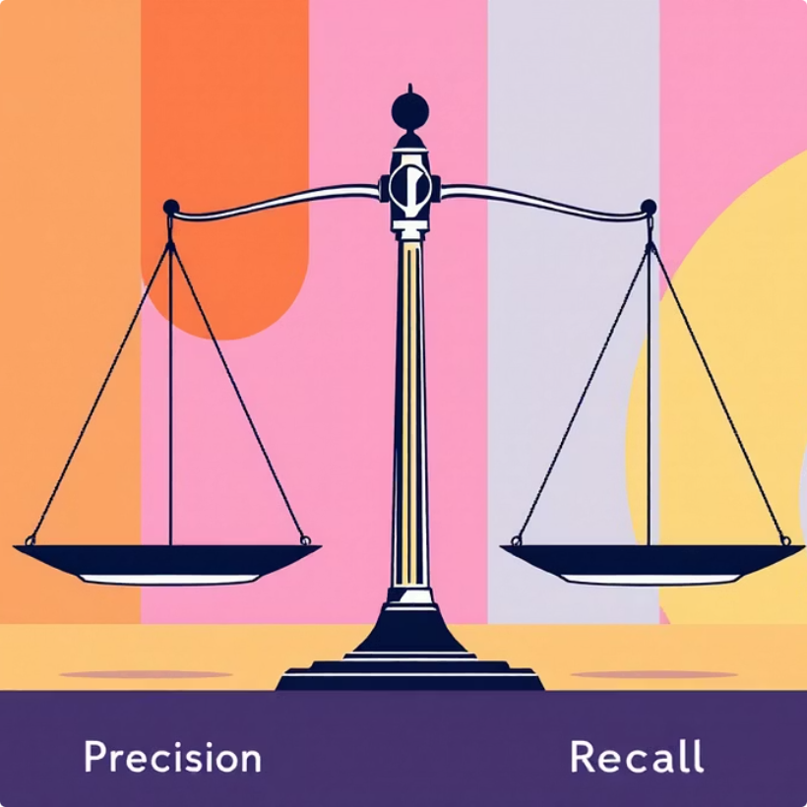


Comprehensive Model Evaluation Framework
Rigorous evaluation using the test set (data never seen during training) ensures your model generalizes well to real-world reviews. Multiple metrics provide different perspectives on model performance, especially crucial for imbalanced datasets where accuracy alone can be misleading.
Accuracy Metric
Precision & Recall
F1-Score
Confusion Matrix
Percentage of correctly classified reviews across all categories. Whilst intuitive, accuracy can be misleading with imbalanced classes where a naive model predicting only the majority class achieves high scores.
Precision measures the proportion of predicted positives that are actually positive, whilst recall measures the proportion of actual positives correctly identified. These metrics reveal the trade-off between false positives and false negatives.
The harmonic mean of precision and recall, providing a single balanced metric. Particularly valuable for imbalanced datasets, ensuring the model performs well on minority classes rather than simply predicting the majority category.
Visual representation showing where the model makes errors, revealing patterns such as frequently confusing Negative reviews as Neutral. Guides targeted improvements and highlights specific areas requiring additional training data or feature engineering.

Slide 9
Deployment and Real-World Testing Interface
Building the User Interface
Example Workflow
Create an accessible testing environment using lightweight frameworks like Streamlit or Gradio that enable rapid prototyping without extensive web development knowledge. These tools provide intuitive interfaces for stakeholders to interact with your trained model.
User Input
Stakeholder enters raw review text into the interface
Core Functionality Requirements
Text Input Component: Allow users to paste or type new product reviews for instant analysis
Preprocessing
Preprocessing Pipeline: Apply identical cleaning, tokenization, and vectorization steps used during training
System cleans and vectorizes the input using trained pipeline
Model Inference: Load the trained model and generate predictions with confidence scores
Result Display: Present the predicted sentiment (Positive, Negative, Neutral) with probability distributions
Prediction
Performance Metrics: Show model confidence levels and explain predictions when possible
Model analyzes features and generates sentiment classification
Display Results
Interface shows predicted sentiment with confidence scores

Slide 10
Next Steps and Advanced Enhancements
Aspect-Based Sentiment Analysis
Multi-Language Support
Extend the pipeline to identify sentiment towards specific product features like "battery life," "camera quality," or "customer service." This granular analysis provides actionable insights for product teams, pinpointing exactly which aspects customers love or dislike.
Expand to international markets by incorporating multilingual models like mBERT or XLM-RoBERTa. Handle code-switching and regional dialects to accurately analyze reviews from diverse global customer bases.
Real-Time Monitoring
Explainable AI Integration
Deploy the model as an API service that continuously analyzes incoming reviews, generating sentiment trends over time. Create automated alerts when negative sentiment spikes, enabling rapid response to emerging issues.
Implement LIME or SHAP to provide interpretable explanations for predictions. Highlight which specific words or phrases contributed most to the sentiment classification, building trust with stakeholders and enabling model debugging.
This comprehensive sentiment analysis pipeline provides a robust foundation for automated customer feedback analysis. By following these systematic steps—from data collection through deployment—you can build production-ready systems that deliver measurable business value through actionable insights from unstructured text data.

